Slide 1

CREDIT CARD APPROVAL PREDICTIVE ANALYSIS
By Team ZENITH (Section 4)

Slide 2
Team Zenith
Divyanshi Singh- U72033788
Naga Poojitha Taduri - U76975993
Geetha Aravinda Reddy Eemani - U36721026
Rohith Rasamalla - U04280535
Mohammed Afeef Shaik - U09061842
Kantheti Sai Pramod - U21182864

Slide 3
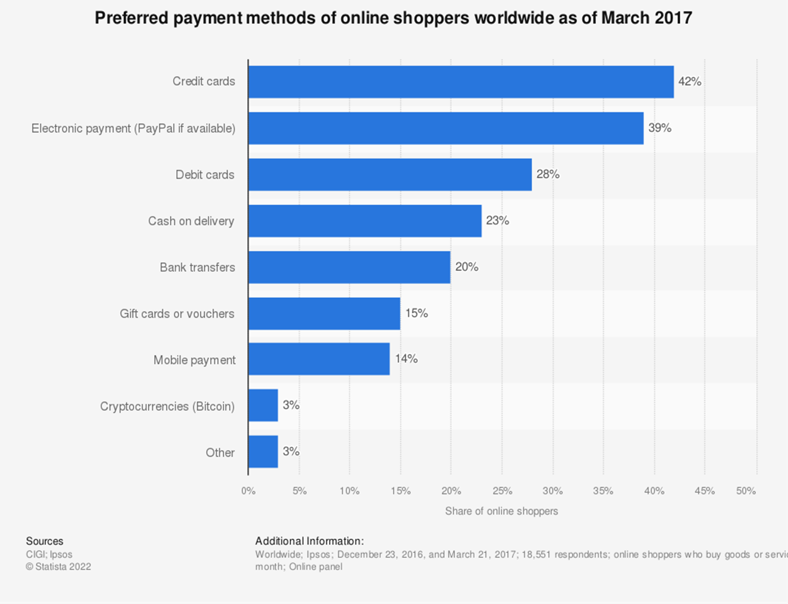
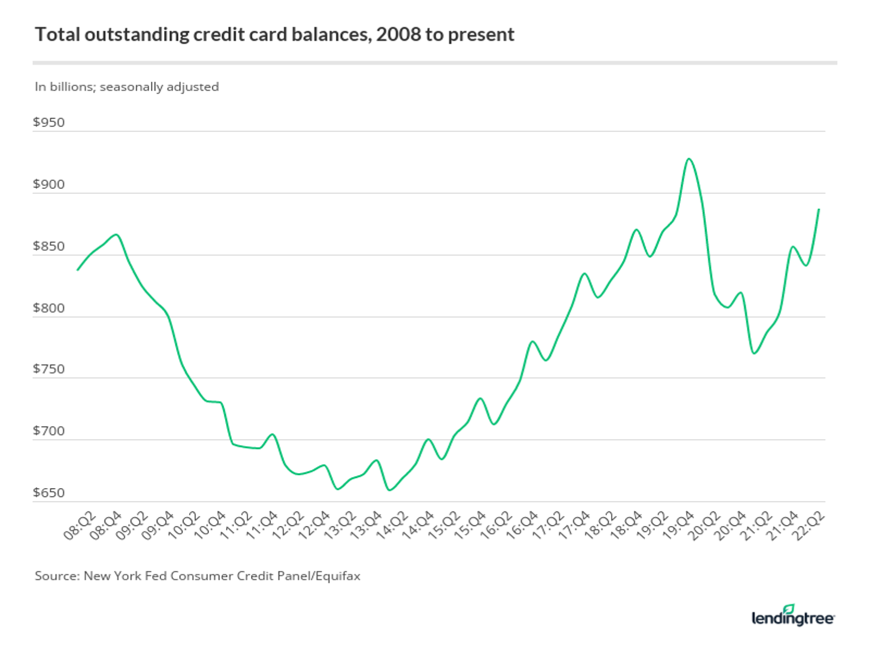
Research Background
Credit cards are the most used card-based payment method among the 9 types of payments. (Statista report 2017)

Slide 4
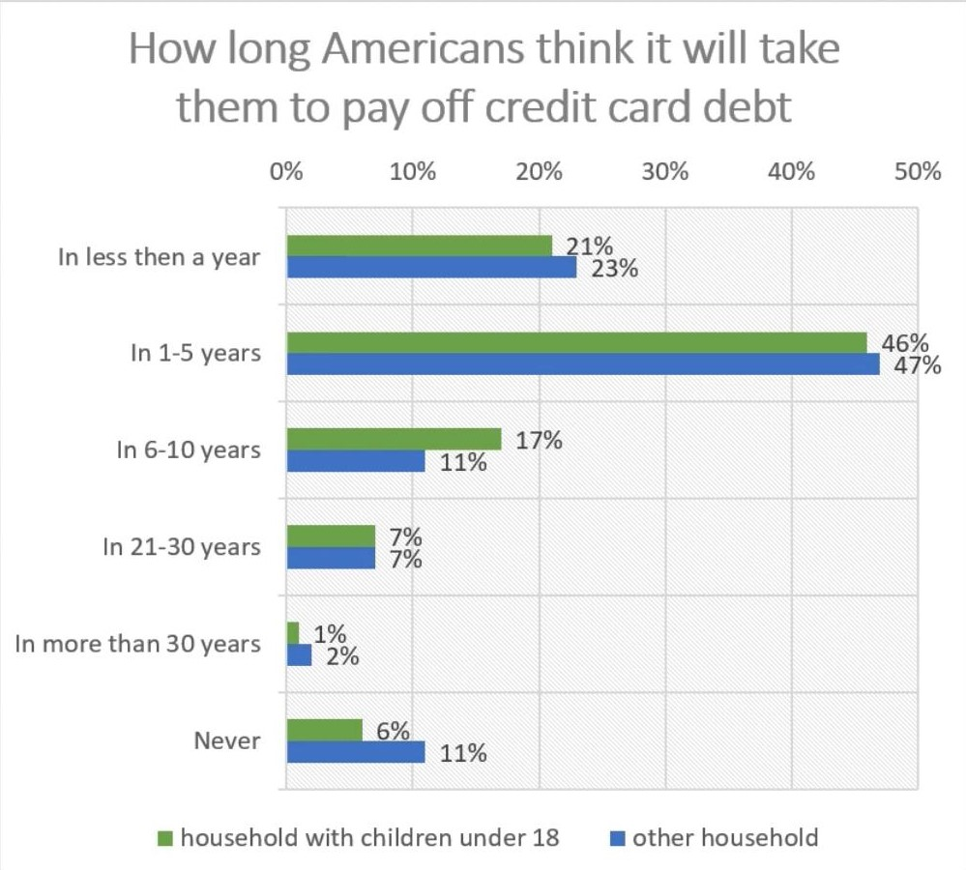
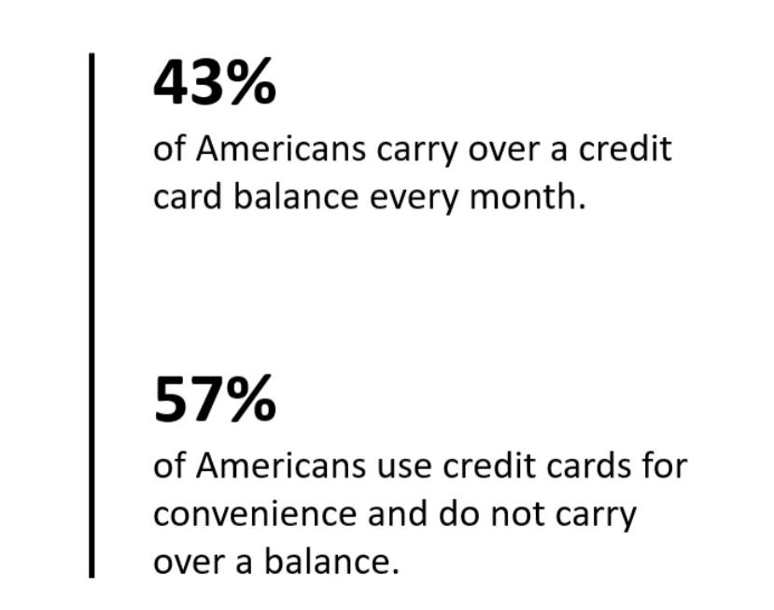
Research Background
50 % of people are living beyond their means, meaning they are spending more than the amount they are receiving. And they are looking for credit cards to cover the extra amount they are spending.

Slide 5
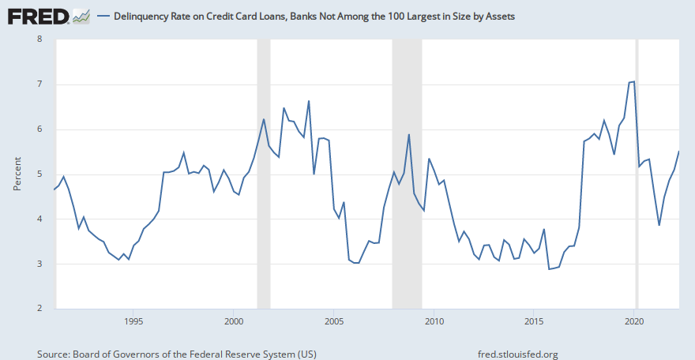
Research Introduction
Problem statement
Unsecured credit instrument : owing is easy, repaying is hard.
Remedies for a default that has occurred : enforcement actions.
Reality : with line effect, default rates continue to rise.
Research Motivation & Study Significance
The most effective solution : build supervised models for credit card approval predictions
Control before happens

Slide 6
Why New Model ?
Most of the small banks and finance companies use manual process for credit card/ loan approval
Also, many large banks use only logistic regression for approval process
In the new model we are trying to use logistic regression including different classifiers
WHERE IS THE DATA COLLECTED
Author has collected data from the bank websites. The bank name is not mentioned because bank information is highly secured and confidential.
HOW IS THE DATA COLLECTED ?
Author has conducted the survey and collected the data from the bank and is available in Kaggle.

Slide 7
Business Challenge
Business problem :
Commercial banks receive a lot of applications for credit cards. Many of them get rejected for many reasons, like high loan balances, low-income levels, or too many inquiries on an individual’s credit report, for example. Manually analyzing these applications is mundane, error-prone, and time-consuming (and time is money!). This task can be automated with the power of machine learning, and pretty much every commercial bank does so nowadays. In this project, we will build an automatic credit card approval predictor using machine learning techniques.
Task :
We will build a machine learning model to predict if an applicant is a 'good' or 'bad' client, different from other tasks, the definition of 'good' or 'bad' is not given. We will analyze the datasets to construct our label. Also, unbalance data problem is a big problem in this task that we will try to solve and come up with a better predictive model.

Slide 8
Opportunities in BA
The machine learning approaches deliver comparable accuracy ratios as compared to rule-based systems.
Automate application scrutiny of input data, statistical combinations and intelligence machine learning (ML) statistics on predicting outcomes
Better opportunities to find and learn from patterns and trends within large datasets to make predictions
Simplified way to answer questions on how banks incorporate additional dimensions they examine during credit risk assessment

Slide 9
Credit Card Approval Factor
To be accepted for a credit card, you’ll need to meet the lender’s eligibility criteria. These factors will be individual to each lender – but typically they will usually include:
Age: The typical age requirement for credit cards is 18 and over.
Income: Lenders will usually want you to be employed and earning a minimum amount each year. This minimum threshold usually beginsat£7,500 a year and can go up to considerably more depending on the card.
Financial history: The majority of lenders will be reluctant to lend if you’ve been bankrupt or you have County Court Judgements (CCJ) against you.
Credit score: Lenders will also base their decision on your credit file and credit score. They’ll use your credit score to determine if it’s likely you’ll make your repayments. Your credit file and credit rating will show how you’ve managed credit in the past.

Slide 10
Description of Data
The data set consists :
The number of rows : 777715 rows
The number of attributes : 20
Target Variable : Status
Classification of target variable : Binary
Data set reference link :
https://www.kaggle.com/datasets/rikdifos/credit-card-approval-prediction

Slide 11
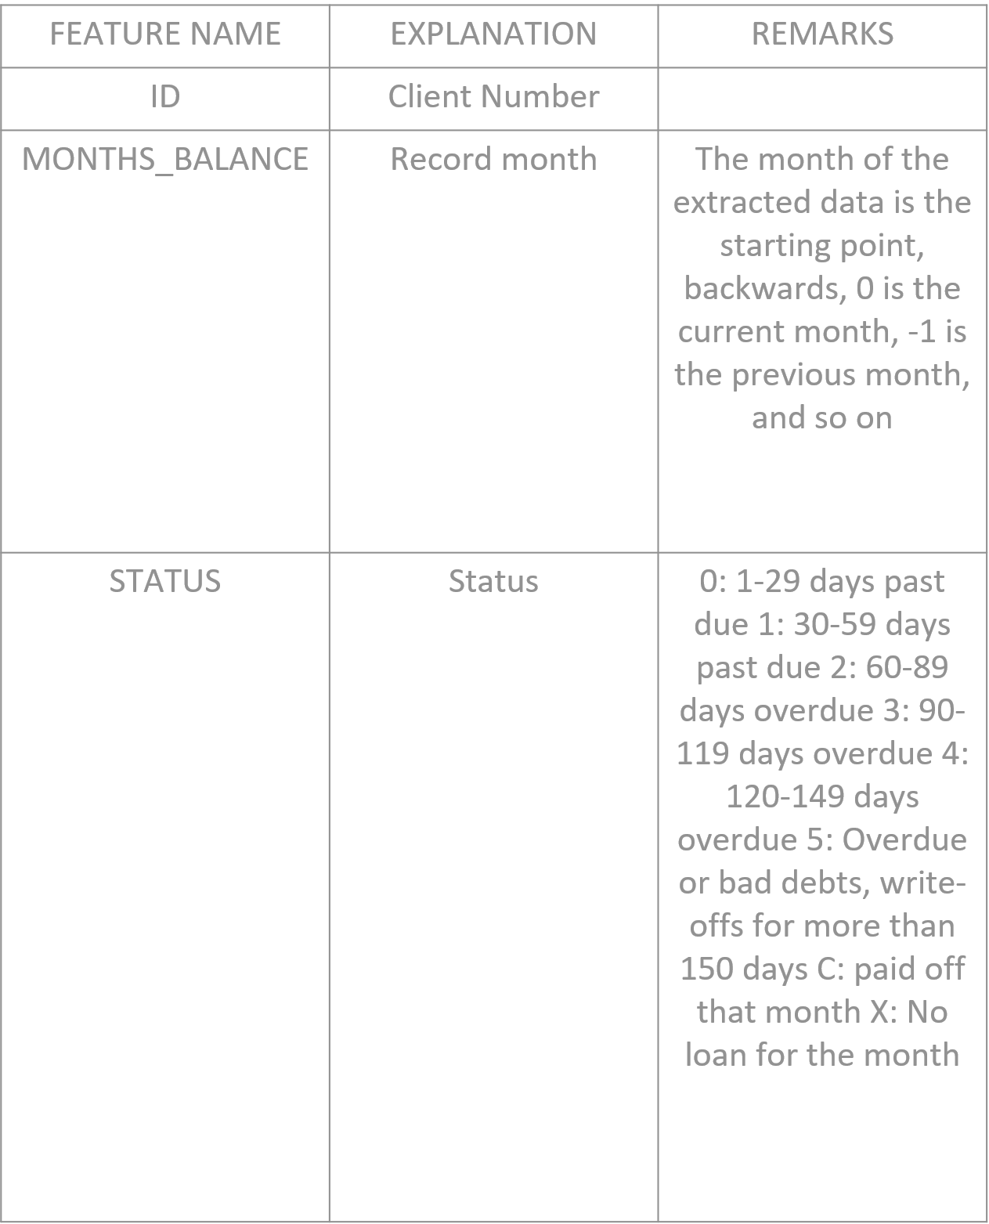
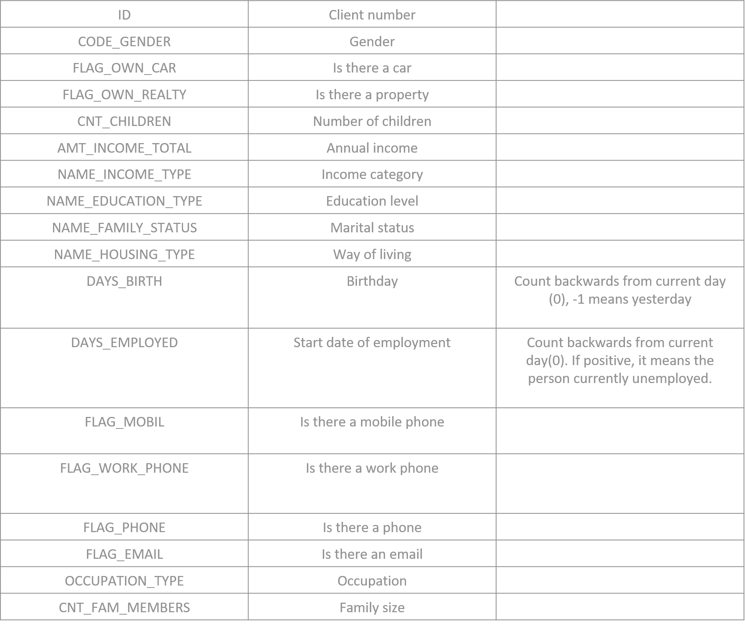
Description of Attributes
CREDIT_RECORD data set
APPLICATION_RECORD data set

Slide 12
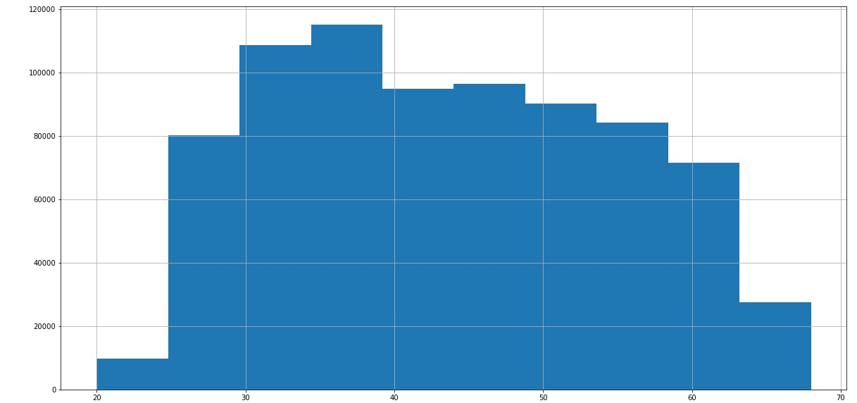
Pre-Processing
We has emerged both datasets on ‘ID’ column, so that we can check the credit record of each applicant
We checked Null-count and datatype of all the columns
Converted Object type to Category type.
We observed that most of the credit card users are in between the age 30 to 40.
Occupation type column has 30% missing values and hence can either dropped or imputed (missing values as unknown)
Major class imbalance observed. Only 0.26% of applicants belong to rejected category

Slide 13
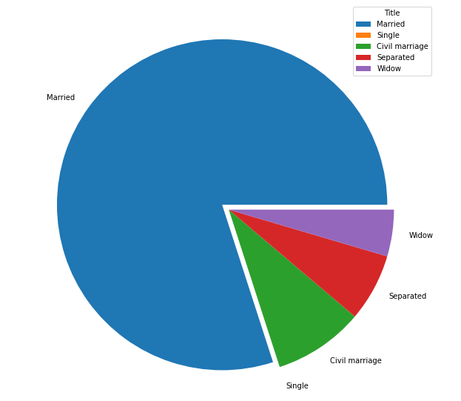
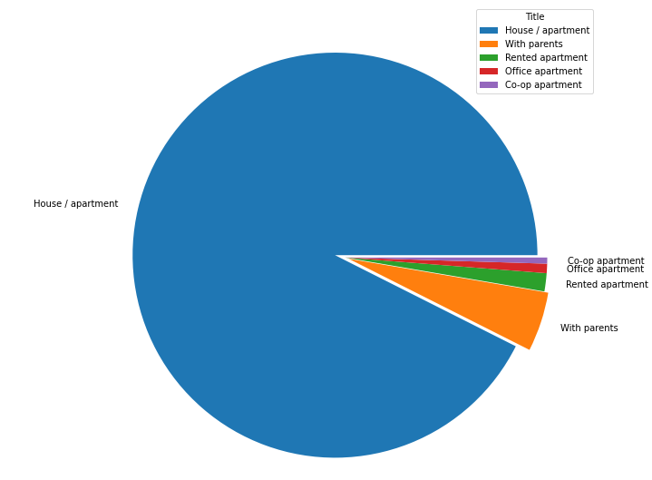
Data Visualization

Slide 14
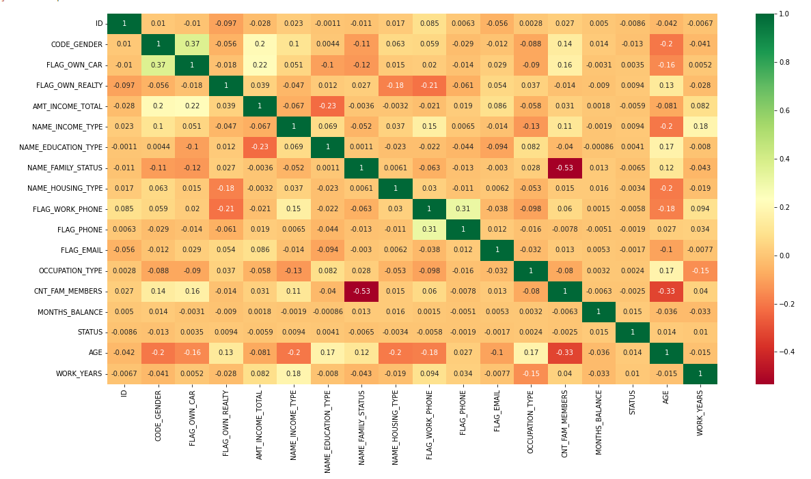
Correlation plot between the attributes

Slide 15
Model Selection
1. Decision Tree
2. Random Forest
3. ADABoost
4. GradientBoost
5. XGBoost
6. KNN
7. Logistic Regression

Slide 16
Model Results

Slide 17
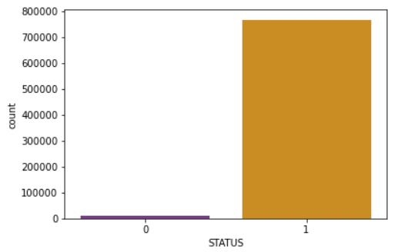
Observations
20% of applicants already paid current month loan.
36.5% of applicants doesn't have loan of the current month.
42.2% of applicants have overdue for 1-29 days.
1.1% of applicants have overdue for 30-59 days.
0.1% of applicants have overdue for 60-89 days.
Ratio of the Customer not approved or bad customer: 1.48%
Ratio of the Customer approved or good customer: 98.51%

Slide 18
Further Enhancements
Improve Performance With Data - Create new and different perspectives on your data
Improve Performance With Algorithms - Identify the algorithms and data representations that perform above a baseline of performance and better than average
Improve Performance With Algorithm Tuning - Get the most out of well-performing machine learning algorithms by tuning techniques
Improve Performance With Ensembles -Combine the predictions of multiple well-performing models

Slide 19
Conclusion
The Random forest classifier gives better results compared with other models as seen from above scores.
Hyperparameter tuning was attempted by executing randomsearchcv and gridsearchcv techniques but didn't much improve the performance of the model.
ROC curve summarizes the tradeoff between true positive rate and false positive rate using different probability thresholds. It plots the relationship between TPR and FPR. More area under the curve i.e., 58 percent, better is the model(Logistic Regression). We have here tried to balance the dataset by under sampling (decreasing the majority approved/good class).

Slide 20
THANK YOU

